Slide 1
United Way:
What’s it all about?
United Way of Dubuque Area Tri-States

Slide 2
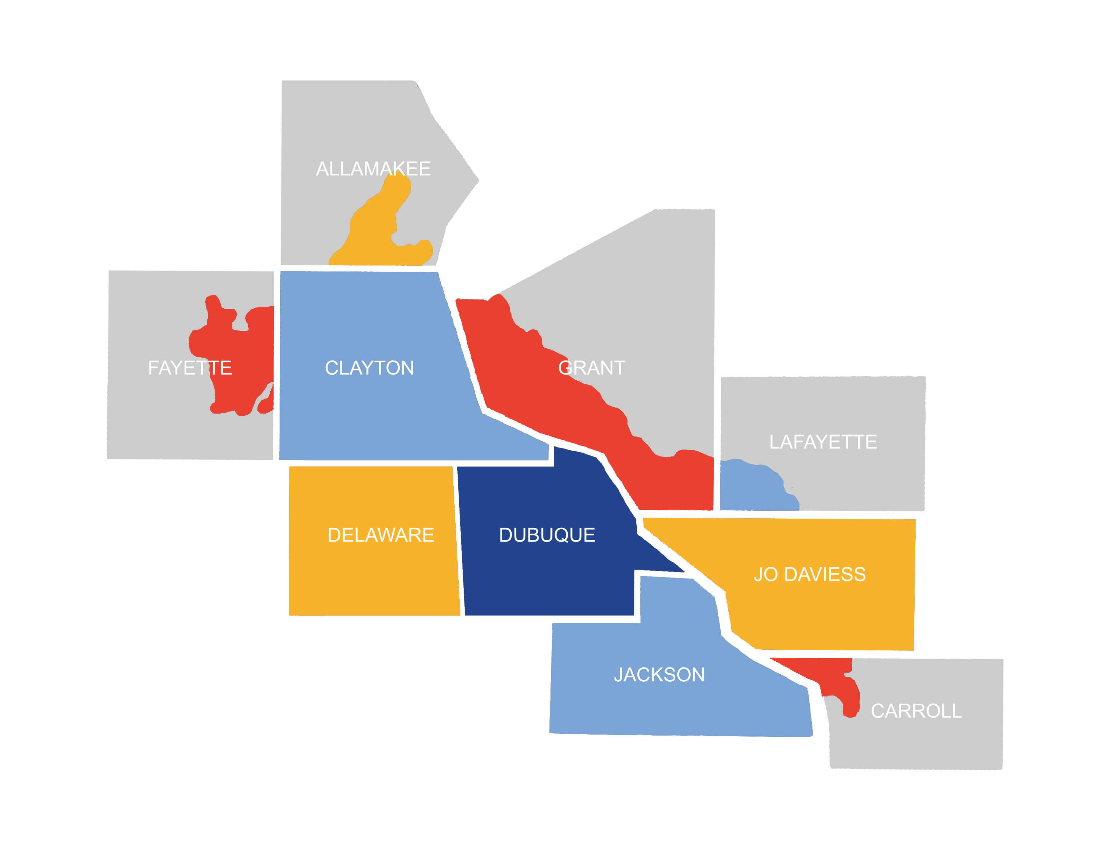
Our Mission & Reach
To connect people and resources to advance the health, education and income of those in need in our community.
Last year, we impacted almost 40,000 lives!
Notes:
Other connections: United Way of Iowa is a statewide connection we are a part of (22 UW cover various parts of the state) and we are a part of United Way Worldwide network so we pay dues to be involved and receive those benefits to support us from the top down

Slide 3
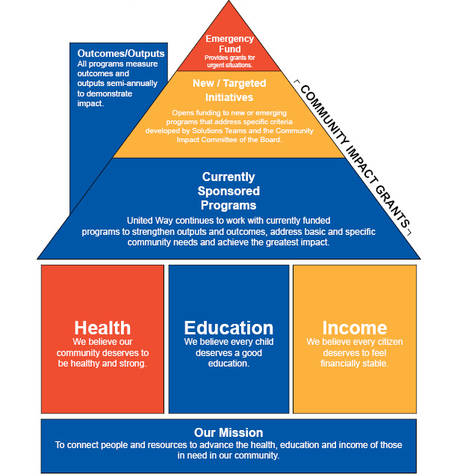
Investment Model
Notes:
Historically, UW was a pass through of funding to nonprofits. In 2000, many United Ways embraced this new model of working in the community to address the decline of annual business campaigns that continue to be a stronghold for UW donor development.
Our UW adopted this plan 5 year community impact transition plan to be reviewed each year and we have just started year 3.
Year one: introduction of model, begin to offer technical assistance to currently sponsored programs
Year two: currently sponsored programs wrote grants to UW for said programs and began receiving technical support around outcome tracking
Year three: currently sponsored programs wrote grants with outcomes and new and targeted initiatives funding is opened up to the community which opened funding for 10 new organizations to join our team serving 13 new programs.
Year four: We opened a 2 year funding cycle and continued with our CSP and N&TI.
Now in our 5th year: we are getting ready to gear up for our fully competitive grant application.

Slide 4



What is our scope of services we support?
Health: our communities deserve to be healthy, safe and strong.
Education: A good education is the foundation for a successful life.
Income: Every citizen deserves to feel financial stability.
Notes:
Total now is 24 organizations serving 35 programs! Will share brief overview of three pillars but will provide the one page handout with the actual info for them to have so we don’t spend too much time here.
Health Pillar overview

Slide 5
UNITED WAY OF DUBUQUE AREA TRI-STATES COMMUNITY ACTION PLAN: United Way addresses specific issues focused on Health, Education and Income/Financial Stability in the communities we serve by convening, collaborating, advocating, and/or investing resources.
Health Our communities deserve to be healthy, safe and strong. TARGET ISSUES: Physical, Mental and Behavioral Health Healthy Eating and Physical Activity Physical Safety Violence Prevention GOALS: Individuals have access to physical and mental health care. Individuals learn strategies to live a healthy lifestyle that support their mental and behavioral health. Individuals engage in healthy eating and physical activity. Individuals are educated about violence prevention and healthy relationships. Victims of disasters or violence have access to services. | Education A good education is the foundation for a successful life. TARGET ISSUES: Readiness to Achieve in School Productive and Engaged Youth Improved Life Skills for Individuals with Disabilities GOALS: Youth have access to a wide range of mentoring options. Elementary and middle school students are prepared to succeed in later grades. Young adults transition to post-secondary education, the workforce or public service. Children and adults with disabilities are enabled to achieve their highest quality of life. | Income/Financial Stability Every citizen deserves to feel financial stability. TARGET ISSUES: Basic Needs Economically Stable Individuals and Families Homelessness GOALS: Individuals have their basic needs met. Individuals have access to stable housing options. Individuals have access to services and learn skills to achieve financial stability and independence.
Notes:
This is the community impact Community Action Plan—have as handout too

Slide 6
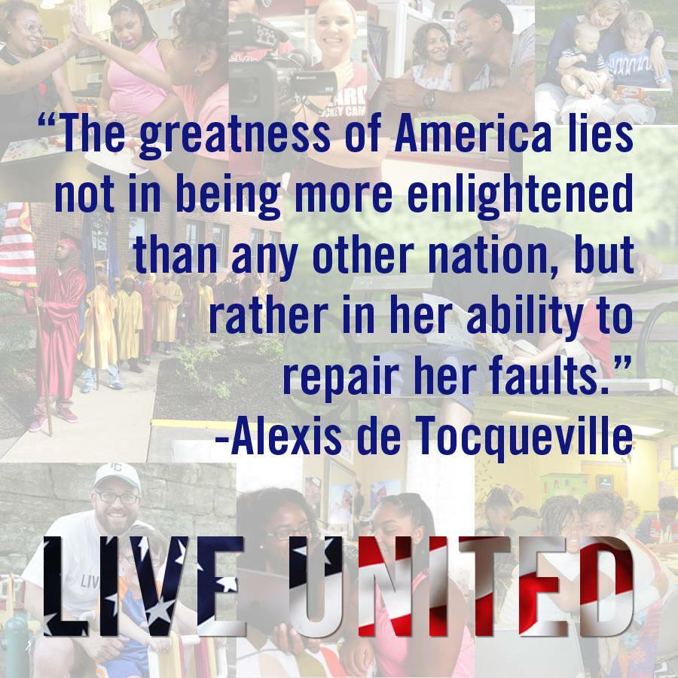
Our message or what we sell is Community Impact and Volunteerism—That’s the link with Resource Development!
Community Impact helps demonstrate the outcomes that are happening because of generous donations from our supporters.

Slide 7

Funded Partner: Boys & Girls Club of Greater Dubuque
Funded Programs:
Meal and Nutrition/Education Program- The Boys & Girls Club of Greater Dubuque addresses local food security by serving over 30,000 nutritious meals and snacks based on USDA guidelines to area low income youth annually.
Triple Play-
The Triple Play program utilizes the mind, body and soul as the key components to ensure we are providing a well-rounded program for some of the most underprivileged youth of our community.

Slide 8

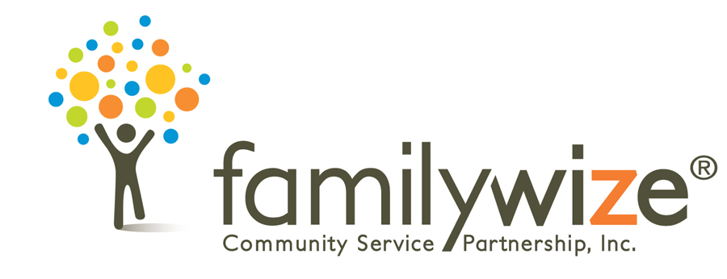
Provided almost 3,000 books to low income youth ages 0-5
Dubuque, Jackson, Delaware
Had over 1,400 calls for referrals including housing, food and utility assistance
Saved over $40,000 for community members on prescriptions
Notes:
As if that’s not enough, we also have these things we fund

Slide 9



Give, Advocate, and Volunteer

Slide 10
United Way’s Leadership Levels
Corporate Levels
Individual Levels
Diamond –$25,000+
Platinum - $10,000-$24,999
Gold - $5,000-$9,999
Silver - $1,500-$4,999
Bronze - $500-$1,500
Alexis de Tocqueville - $10,000+
Chairperson’s Circle - $5,000-$9,999
President’s Circle - $1,500-$4,999
Director’s Circle - $500-$1,499
Women United - $500+
Young Leaders’ Society - $250+
Legacy Society – lifetime giving of $100,000 or notified United Way of a bequest
Loyal Donor- 5 years of consecutive giving
Notes:
We have young leaders' society but I don’t think we ask age anywhere consistently on pledges. Also “young leaders” is under 30?

Slide 11
ADVOCATE
You can raise your voice with us by writing to your local elected officials, keeping up-to-date on policy changes, engaging in social media discussions, or attending United Way’s Day on the Hill.
Be a Hand Raiser, Game Changer, Impact Maker and Trail Blazer! Join us and advocate for the issues that are important to you.

Slide 12
Volunteerism is a great way to show value to a community—Last year, 19,285.5 volunteer hours were provided to local non-profits, which equates to a value of $475,159 for our community.
Get Connected portal on our website matches volunteers with nonprofit needs
Group volunteer experiences can be arranged through our Volunteer Engagement Coordinator
Active in community meetings to learn of needs and opportunities
  UW staff participate in local committees/partnerships around the following areas, to name a few:
      Food scarcity
      Homelessness
      Wellness
      Disaster preparedness
      Mentorship
Notes:
Get connected over 4,000 people have individual profiles and over 115 nonprofits, growing every day
Dollar amount associated with a volunteer hour so it’s important we capture it

Slide 13
Questions?
Website: www.dbqunitedway.org
Facebook dbqunitedway
  Twitter: https://twitter.com/unitedwaydbq
  Instagram: https://www.instagram.com/unitedwaydbq
Follow us, like or share posts or give a review; Invite your friends to like our social media pages too!

Slide 14
Give.
Advocate.
Volunteer.
Thank You!
United Way of Dubuque Area Tri-States

